Slide 1
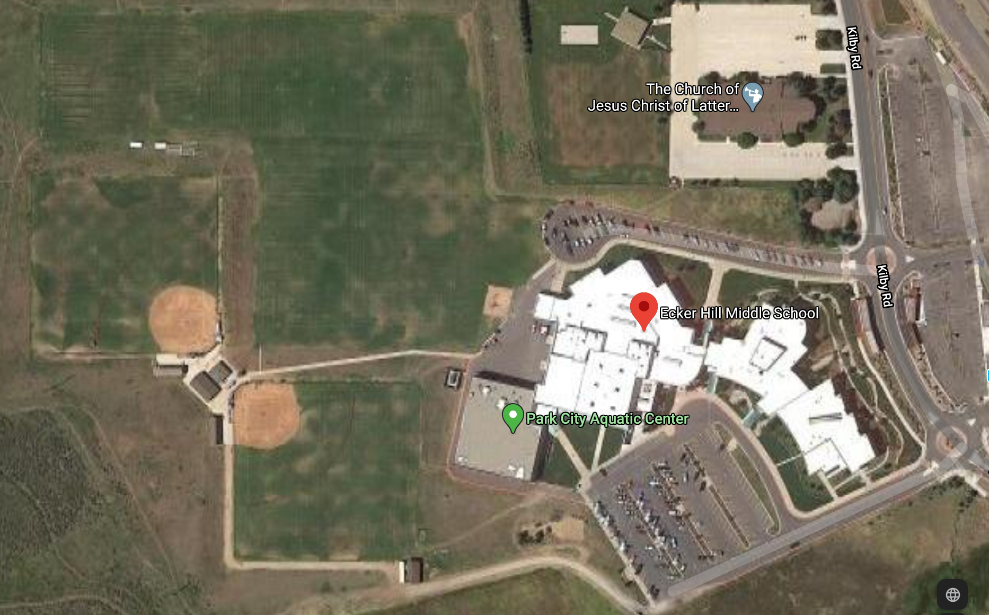
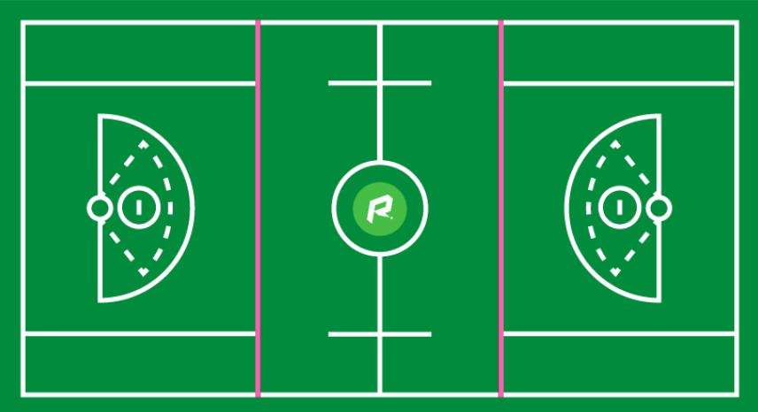
Field 3
No Parking
Field 4
Field 2
Parking
Team Drop Off
No Parking
Field 5
Fire lane

Slide 2
Field 3
Tribal West Vendor
IMLax/Tournament Tent
Field 4
Field 1
Field 2
First Aid/Trainer
Bathrooms/Port a potti
Field 5

